Slide 1
Navigating Speedy Success
Cyclistic
August 2021

Slide 2
Objective:
Discover how annual members and casual users use Cyclistic bikes differently.
Findings:
Annual members use Cyclistic as a transport solution for short, recurring trips.
Casual users use Cyclistic primarily for weekend trips and can make longer
(30+ min) trips.
Casual users hypothesized to use Cyclistic as an alternative transportation solution due to winter month drop-off.

Slide 3
Goals for analysis:
Identify key use-case for each user type.

Slide 4
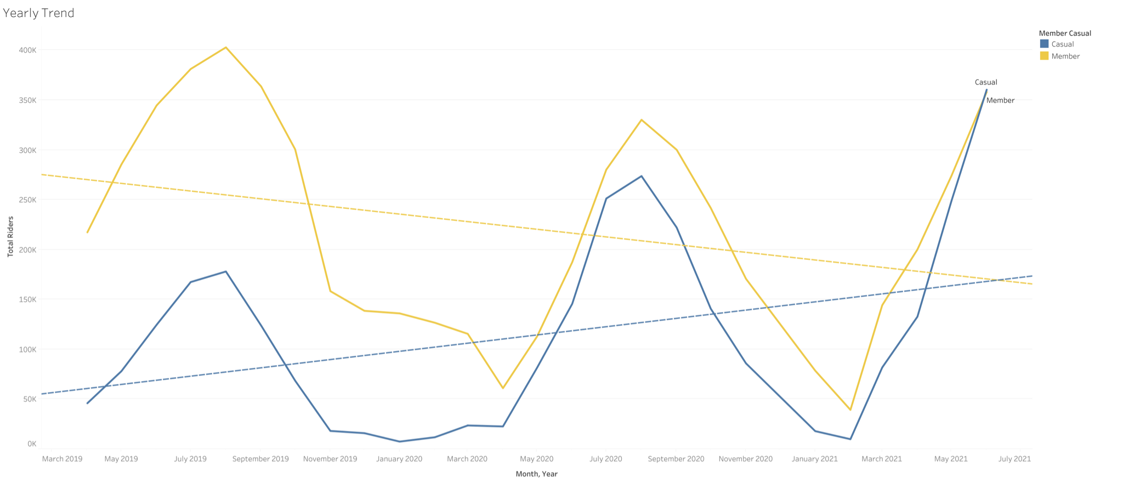
Annual members trending down.
Casual users are trending up.

Slide 5
0 - 30
minutes
Analyzing 3 time-frame buckets for use-case.
30 - 60
minutes
60+
minutes

Slide 6
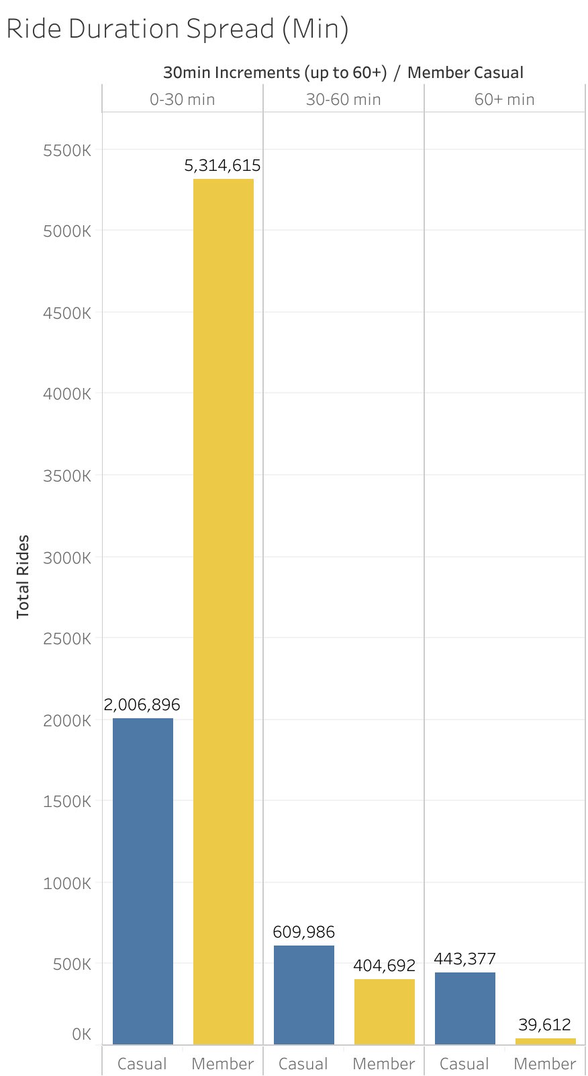
83.01% of users
take 0-30 minute rides.
Annual members take more than 2x amount of 0-30 minute rides.
Casual users take more 30+ minute rides.

Slide 7
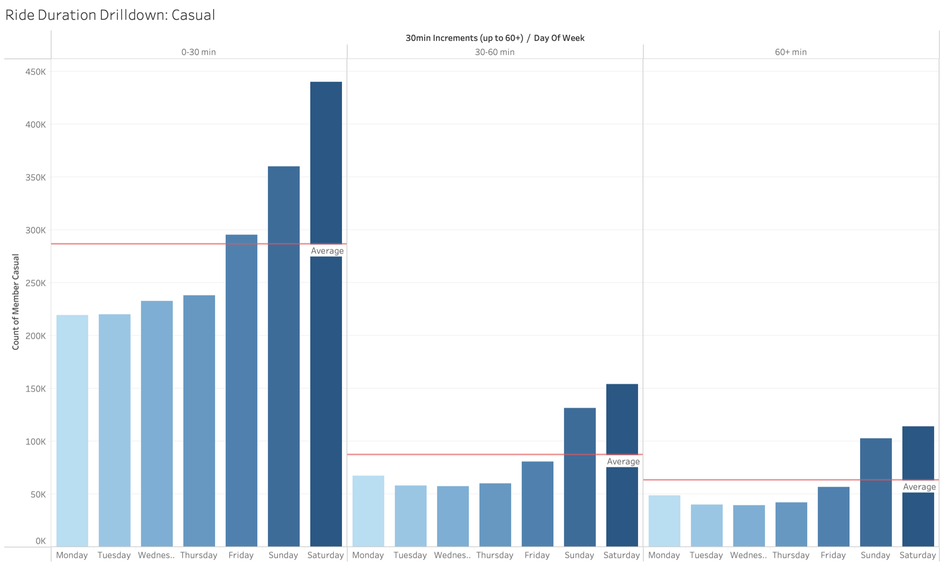
Casual Users
Similar use patterns in each bucket.
Notes:
Similar use patterns– implies that regardless of whether the rides are 0-30min, 30-60min, or 60+ min, casual users are using for similar purposes.

Slide 8
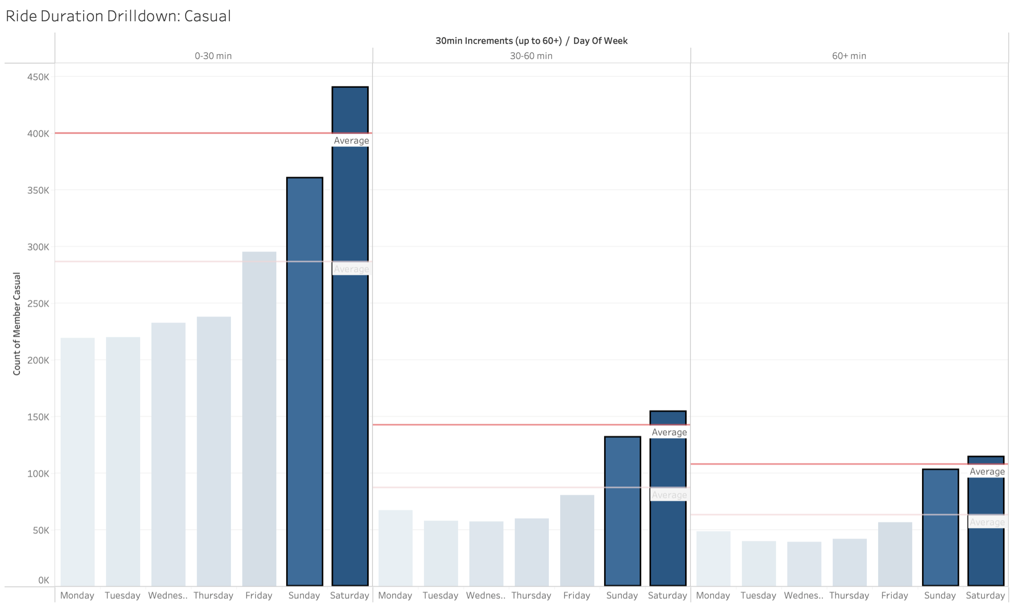
Casual Users
Noticeable increase in usage toward weekends for all buckets.
Notes:
Implies casual users are mostly composed of users for leisure.

Slide 9
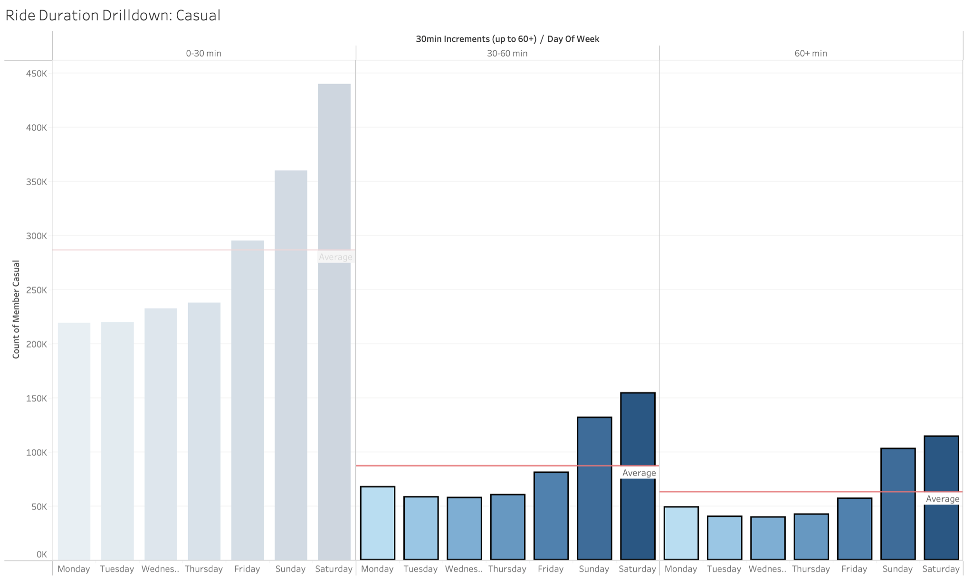
Casual Users
Less, but significant usage for longer (30+ min) rides.
Notes:
Longer rides could mean multiple things.

Slide 10
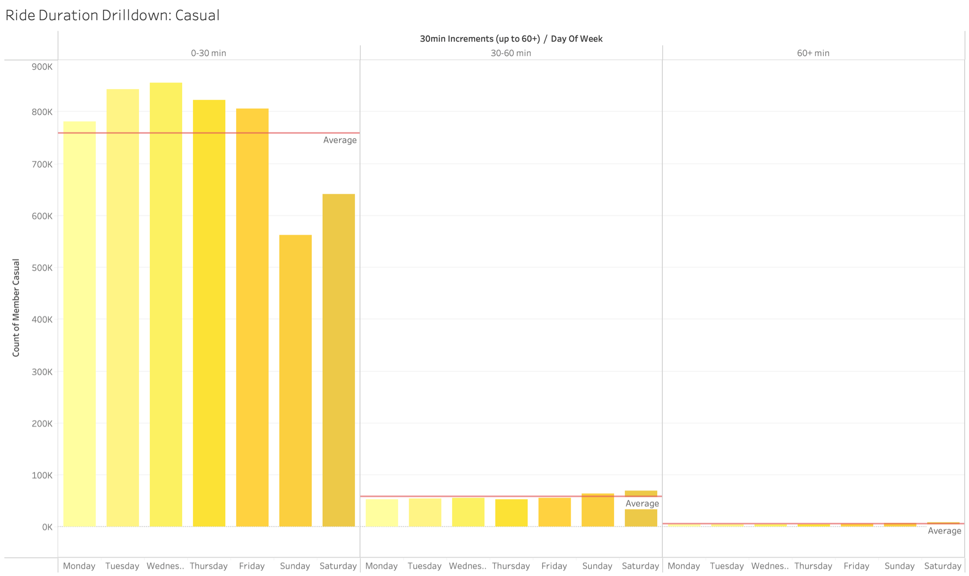
Annual Members
Concentrated 0-30 minute usage.

Slide 11
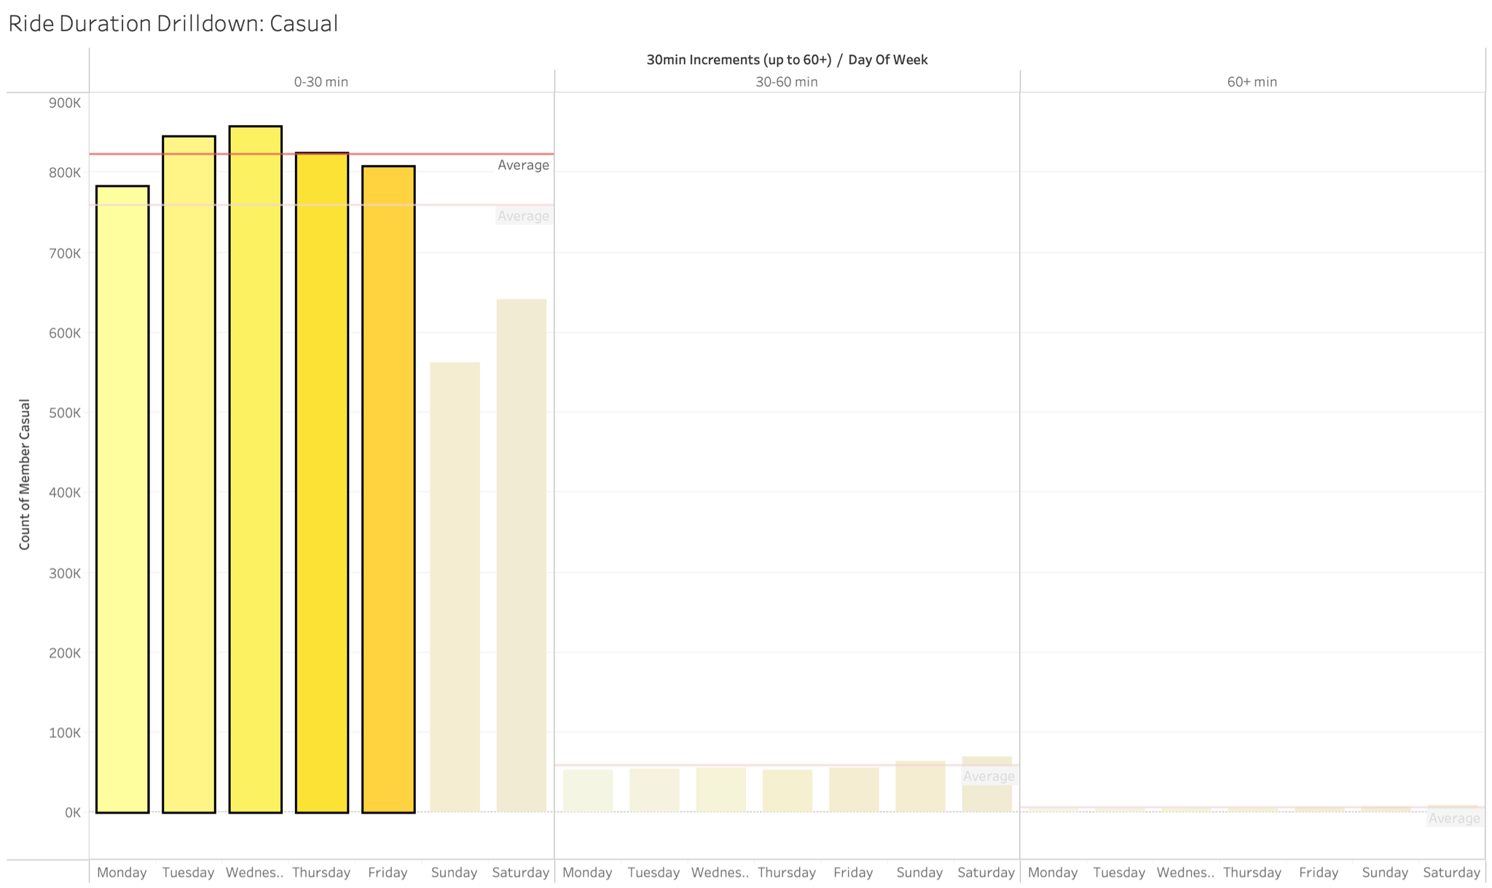
Annual Members
Significant weekday usage within 0-30 min segment.

Slide 12
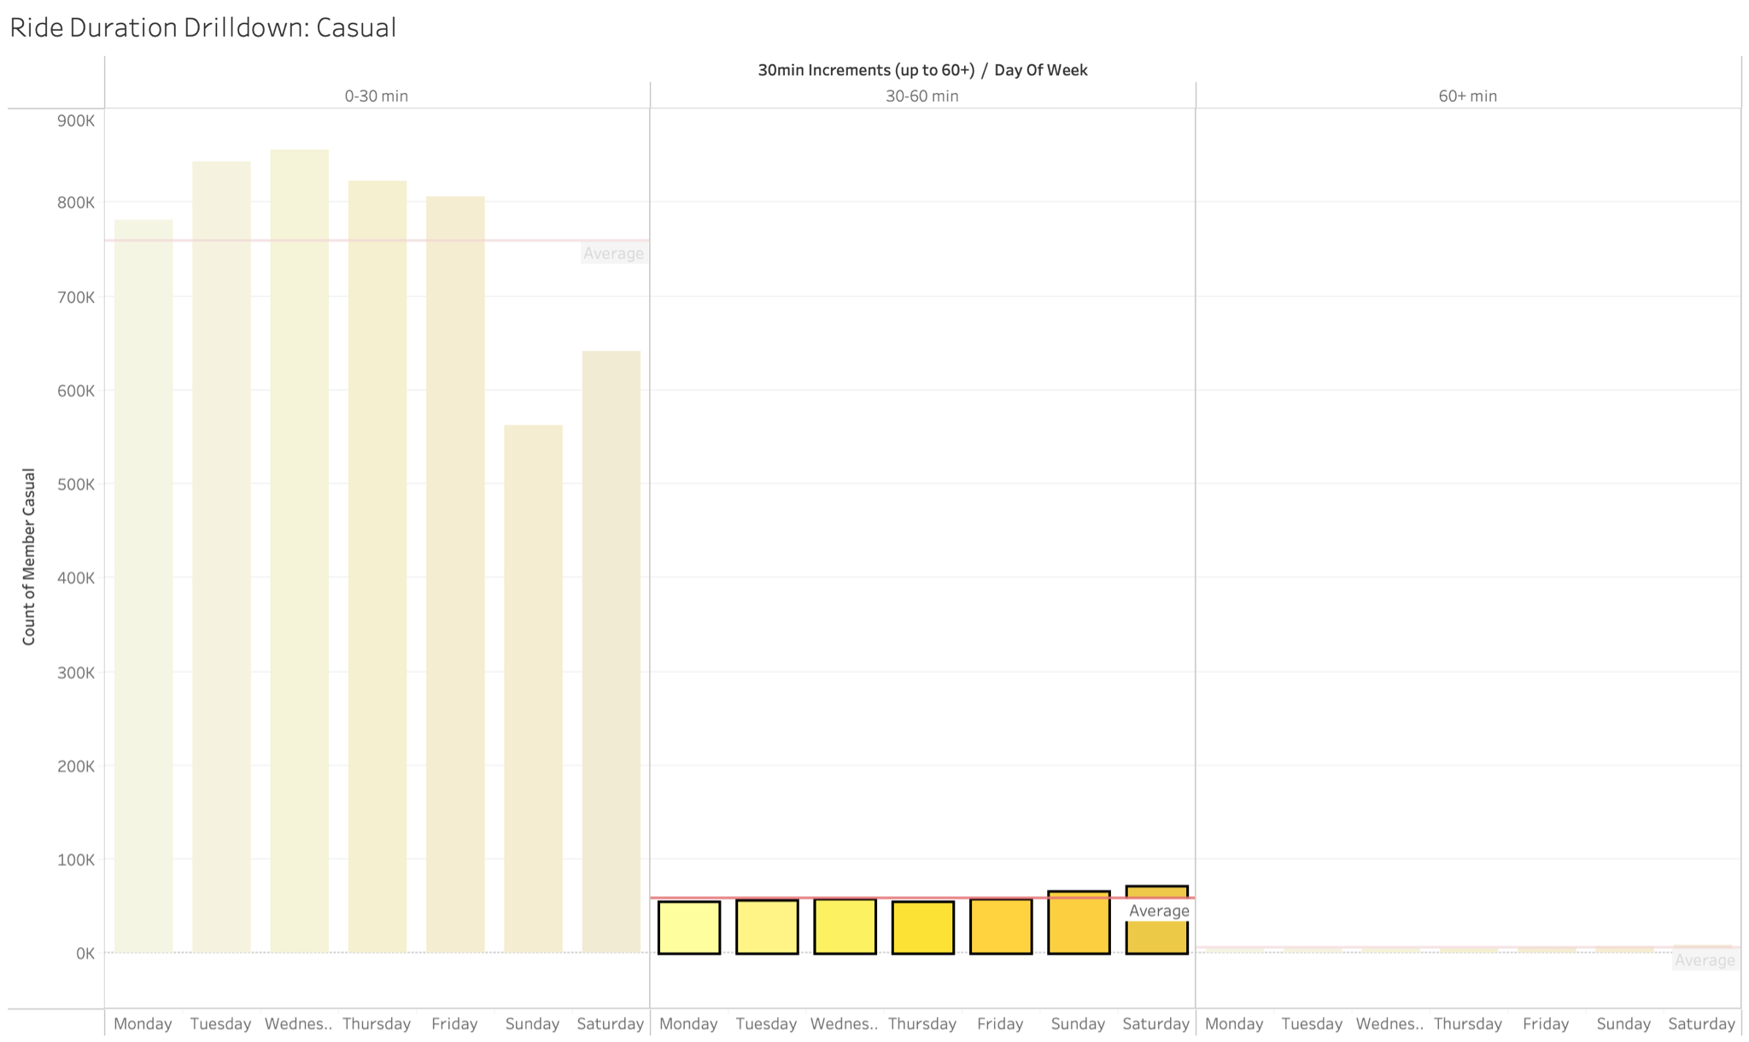
Annual Members
30-60 min segment sees departure from use pattern.
Notes:
Make comment on how it is similar to casual user’s use patterns.

Slide 13
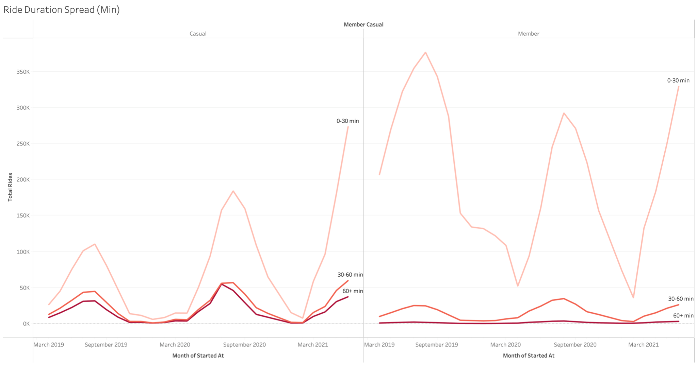
Comparison
Overlapping 0-30 minute use cases between user types.
Members do not capture 60+ min riders.

Slide 14
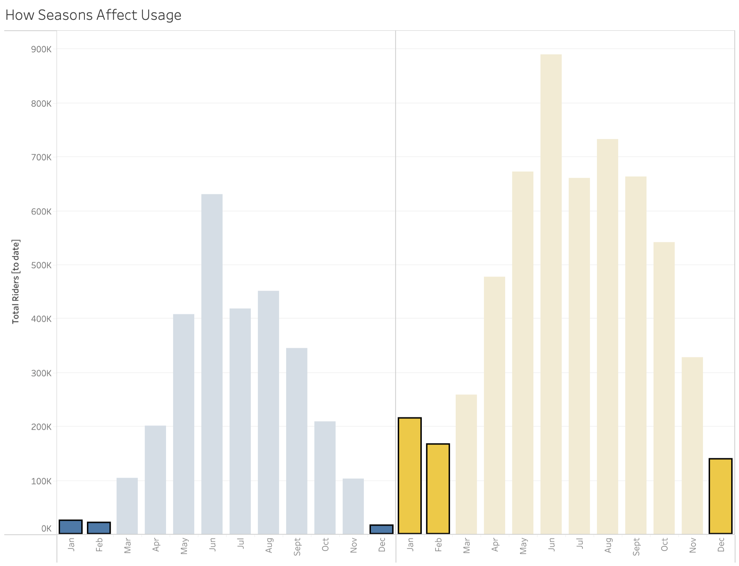
Comparison
Annual members retain usage through winter months.

Slide 15
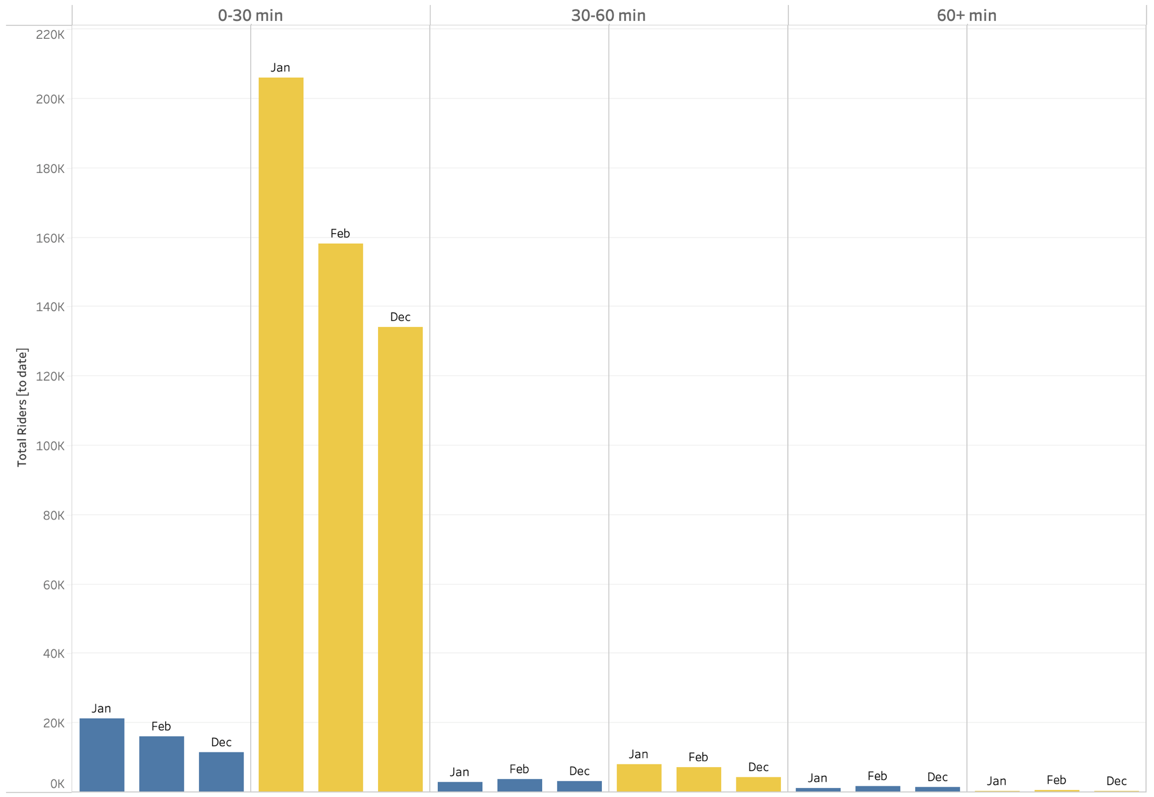
Comparison
Annual members still primarily take 0-30 min rides during winter months.
Notes:
Since casual users let go when the seasons turn unfavorable, it’s safe to say they have an alternative method of transportation.

Slide 16
Hypotheses
Annual members use Cyclistic as a primary transport solution for short, recurring trips.
Casual users use Cyclistic primarily for weekend trips and can make longer
(30+ min) trips.
Casual users hypothesized to use Cyclistic as an alternative transportation solution due to winter month drop-off.
Notes:
Point 1: Annual members riding during unfavorable winter months is evidence/suggests that Cyclistic or bicycles are their primary method of transportation.
Point 2: Weekend trips are most likely for leisure or exercise. Longer trip durations do not necessarily mean leisure trips.
Point 3: Since casual users drop off during winter months, they need to have alternatives to transportation.

Slide 17
Recommendations
Incentivize longer (30+ min), weekend trips through membership with discounts.
Target marketing messages for utility riders who have short, recurring rides.
Build docking stations close together (<30 mins).

Slide 18
Further exploration
How many 60+ minute rides are results from user error when returning bikes?
Do different bike types have impact on users?

Slide 19
Data
Data sources:
Divvy_Trips_2019_Q2.csv
Divvy_Trips_2019_Q3.csv
Divvy_Trips_2019_Q4.csv
Divvy_Trips_2020_Q1.csv
202004-divvy-tripdata.csv
202005-divvy-tripdata.csv
202006-divvy-tripdata.csv
202007-divvy-tripdata.csv
202008-divvy-tripdata.csv
202009-divvy-tripdata.csv
2020010-divvy-tripdata.csv
202011-divvy-tripdata.csv
202012-divvy-tripdata.csv
202101-divvy-tripdata.csv
202102-divvy-tripdata.csv
202103-divvy-tripdata.csv
202104-divvy-tripdata.csv
202105-divvy-tripdata.csv
202106-divvy-tripdata.csv
Data limitations
Flawed start and end times resulting in negative ride lengths
Empty end stations -- will need to confirm with stakeholders whether bikes are stolen or system fault
Bike ID system has changed, historical data is not relevant/useful for identifying bike types.

Slide 20
Data Documentation
Handled and manipulated data in SQL.
Combined multiple sources
JOIN together sources using primary key
Removed data with negative ride durations
Removed duplicates
Removed unnecessary information
Added new dimensions for analysis
Please view code and documentation here.

